Slide 1

Functional Interfaces
Bhawna Gunwani

Slide 2
Functional Interface
Functional interfaces were introduced in Java 8.
Functional Interface in Java is also called Single Abstract Method (SAM) interface.
A functional interface can contain only one abstract method.
It can contain any number of static and default (non-abstract) methods.
Abstract methods are the methods that do not require implementation during their declaration.
They must be overridden by the class implementing the interface.
Default methods can be directly used in a class implementing the interface.
They can also be overridden and redefined by the classes implementing the interfaces.
Static methods are required to be called using the name of the interface.
They cannot be overridden by the classes implementing the interface.

Slide 3
Functional Interface
There are Two Ways to Use Functional Interfaces in a Class:
Using Lambda Expression
Lambda expressions are just like methods in java, but they make the code short, clean, and readable. They are also called anonymous functions. Thus, they are used more frequently with functional interfaces in Java.
By Implementing the Interface
By doing so we will have to override the abstract method. Then to call the method we are supposed to create the object of our class and use the following syntax obj.AbstarctMethod().

Slide 4
Built-in Java Functional Interfaces
Java has pre-defined functional interfaces for commonly occurring cases. Many interfaces are converted into the functional interface. using @FunctionalInterface Annotation. A few of these interfaces are as follows-
Runnable - It contains only the run() method.
Comparable - This interface contains only the compareTo() method.
ActionListener - It contains only actionPerformed() method.
Callable - It only contains the call() method.

Slide 5
Types of Functional interfaces
Consumer
Function
Predicate
Supplier

Slide 6
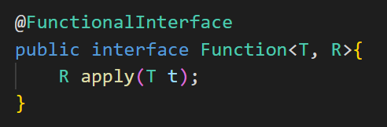
Function Interface
The function type functional interface receives a single argument, processes it, and returns a value. One of the applications of this type of functional interface is taking the key from the user as input and searching for the value in the map for the given key.
Function Syntax:
Explanation: @FunctionalInterface is an annotation to ensure our interface is functional only. The function takes two generic types. The first one T is the type it takes a parameter and R is the return type of the abstract method. apply() is the abstract method of the Function.

Slide 7
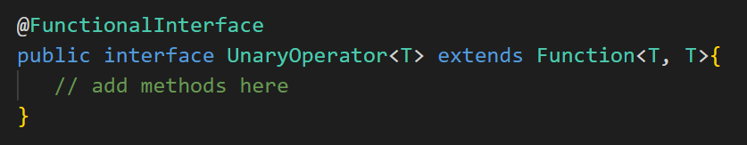
Function Interface
Bi-function is just like a function except it takes two arguments. Two arguments are must in Bi-function. Just like a function it also returns a value.
Unary and Binary are two functional interfaces.
Unary extends Function and Binary extends Bi-function functional interface. Thus, Unary excepts one argument and returns a value,

Slide 8
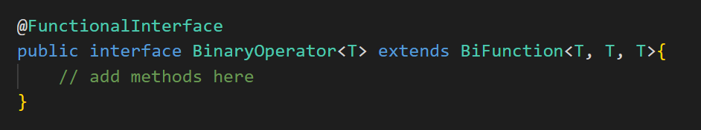
Function Interface
Binary takes two arguments, but they must be of the same type. Also, the return value must be of the same type as the argument(s) for Unary and Binary operators.

Slide 9
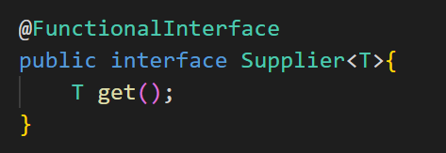
Supplier Interface
The supplier functional interface in Java is much like a functional interface, the only difference is it doesn't take any arguments. On calling the supplier it simply returns a value. Supplier is a generic interface thus; it takes the type of value in <> (Angular brackets) while implementing to be returned by the get() method.
Supplier Syntax:
The supplier takes only one generic type, the type of data it is going to return. get() is the abstract method of the Supplier.

Slide 10
Consumer Interface
There are Two sub-types of Consumer Interface:
BiConsumer
Represents an operation that accepts two input arguments and returns no result.
This is the two-arity specialization of Consumer.
Unlike most other functional interfaces, BiConsumer is expected to operate via side-effects.
This is a functional interface whose functional method is accept(Object, Object).
intConsumer
Represents an operation that accepts a single int-valued argument and returns no result.
This is the primitive type specialization of Consumer for int.
Unlike most other functional interfaces, IntConsumer is expected to operate via side-effects.
This is a functional interface whose functional method is accept(int).

Slide 11
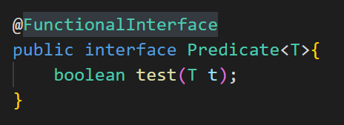
Predicate
The predicate functional interface in Java takes a single argument and returns a boolean value. It is usually used in filtering values from the collection. Predicate interface in Java has 3 default methods and(),negate(), and or and 1 static method isEqual() other than abstract method test.
Predicate Syntax:
Predicate's abstract method returns a boolean value. It takes a paramters of the type T. test() is the name given to its abstract method.
Notes:
It is also a specialization of a Function that takes a gentrified argument or a single argument and returns a boolean. The predicate is much like a metal detecting machine. It tests each object. If the object is detected to be metal, it sends signals in the form of sound or light, i.e. returns true. If the object is not metal, it simply checks another object or returns false.

Slide 12
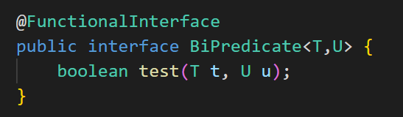
Predicate Interface
It is an extension of Predicate Functional Interface. It takes two arguments instead of one and returns a boolean value. Bi-Predicate can be implemented just like Predicate, the only difference being that we will have to import BiPredicate and pass two parameters instead of one.

Slide 13
Summary
Functional interface can have only one abstract method.
It can contain multiple default and static methods.
abstract keyword is optional as by default all the methods of the interface are abstract only.
The java.util.function contains in-built functional like Function, Consumer, Supplier, etc.
Functional interfaces are interfaces with a single Abstract method (SAM).
Though it can have multiple default as well as static methods.
@FunctionalInterface annotation and abstract keyword are optional.
We can implement the abstract method in sub class using a lambda expression.
Some predefined functional interfaces are Runnable, Comparable, ActionListener, Callable, etc.

Slide 14




Thank you

